Slide 1
R Shiny for Operations
Instructor: Geoffrey Arnold

Slide 2
Agenda
Course Details
Intro to Digital Services
R Projects
Git & GitHub

Slide 3
Course Details

Slide 4
Class Logistics
There is no required text for this course, but supplemental websites and materials will be provided
There will 2 graded projects and 3 homework assignments
The lowest homework grade will be dropped
Each student will be required to submit their own code for assignments but working with a partner or group is encouraged.
Assignments will be due on Friday at Midnight
Syllabus & Homeworks

Slide 5
R Style Guide
We will be using the Google R Style Guide for this course: https://google.github.io/styleguide/Rguide.xml#comments
Note the passage on commenting as all graded code will require comments so I know what your code is supposed to accomplish.

Slide 6
TA Info

Slide 7
About the Instructor
Education:
University of Pittsburgh: BA Political Science & History 2010
Heinz College: MS PPM 2015
Professional:
PA State Democratic Party: Field Organizer 2010
City Year Greater Philadelphia: Senior Corps Leader: 2011-2012
Lutheran Child & Family Services: Group Leader 2013
City of Pittsburgh: Senior Digital Services Analyst 2015-2017

Slide 8
What are digital services?
Eh?

Slide 9
US Digital Service & 18 F
“The mission of the U.S. Digital Service is to deliver better government services to the American people through technology and design.”
https://www.usds.gov/mission.html
“We develop partnerships with agencies to help them deliver exceptional digital experiences that address their strategic initiatives. Through our work together, we also aim to strengthen government technology practices in ways that last beyond our formal partnerships. We effect change by practicing user-centered development, testing to validate hypotheses, shipping often, and deploying products in the open.”
https://18f.gsa.gov/about/

Slide 10

How do you do that in Pittsburgh?
We’ve developed end-user applications in R, JS and more to help City Departments do their work by building custom applications.
Applications Include
Burgh’s Eye View (public)
Maintenance Request Form
Pothole Dashboard
And more

Slide 11
R Projects
Easy Organize your Code

Slide 12
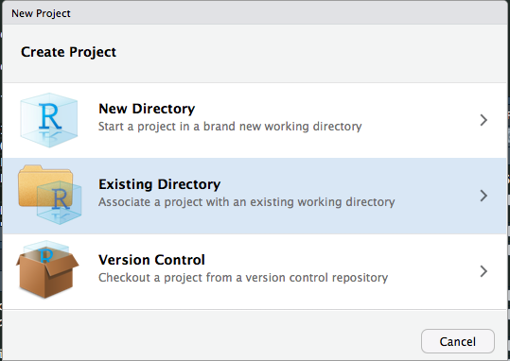
Why R Projects?
R Projects are great for if you’re working on multiple analyses
When you load a project your Objects from the last time you were working on it are brought over
You had to reload your Libraries, as opening a project starts a new R Session.

Slide 13
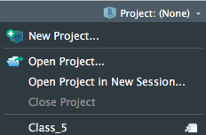
It’s not to late to convert to all your scripts to Projects!
If you’ve already started working on something and want to switch it to an R Project simple select Existing Directory
When you want to go back to this project you can select it from the project drop down
You can open projects in a “New Session” and have to different windows of R Studio running at the same time
Multitasking

Slide 14

Git & GitHub
The big save button in the cloud

Slide 15
GitHub What to do:
All course materials are available through GitHub: https://github.com/RforOperations2018/
Download GitHub for Desktop: https://desktop.github.com/
Create an account: https://github.com/join
Follow the Course repository (repo)
All of your projects should have their own GitHub repo.
This is so I can see what you tried, and also determine who did one on any group work.

Slide 16

What’s all this?
GitHub is a form of Git.
So what’s Git?
Git “provides access control and several collaboration features such as bug tracking, feature requests, task management, and wikis for every project.” -Wikipedia
There’s also GitLab
GitHub was bought by Microsoft in 2018.
After this course you can switch to them if you have an aversion to using a Microsoft product

Slide 17
How to use Github
Select lines to “commit” to your code, add comments and title each commit.

Slide 18
Important things
.gitignore File
This is where you can hide things from the public repo.
Good for passwords or really large files
You don’t have to do all of your commits from your last change at once.
This is helpful if you changed multiple things that were unrelated.
Best practices:
Save all passwords, API keys in an “.REnviron” file or some of file type and add that file to load into your application

Slide 19
Show & Tell

Slide 20
Git in R Studio
Once you’ve installed GitHub Desktop, you don’t have to use Desktop

Slide 21
Where is it?
In your top right tabs
Note: You’ll probably need to restart RStudio

Slide 22
Linking an R Project and GitHub

Slide 23
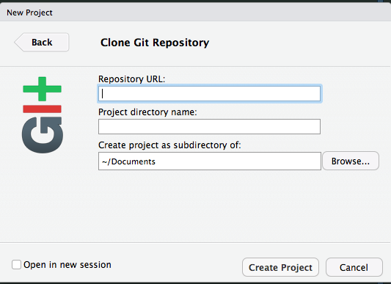
Linking an R Project and GitHub
If you’re bringing in a repo from GitHub that has already been published you use the Version Control option

Slide 24
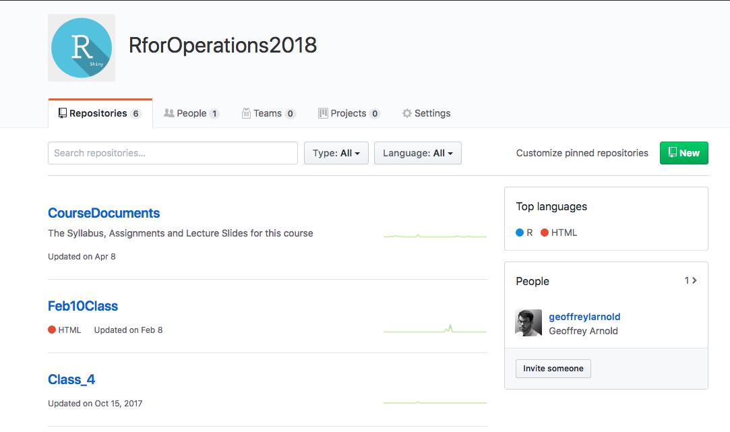
GitHub Website
You can add repos from here or by publishing them from GitHub Desktop

Slide 25
Show & Tell

Slide 26
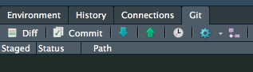
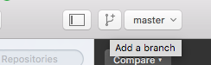
Branches
Branches are great for when you are making major revisions or testing out a change to your application that you’re not ready for.

Slide 27
Getting Halp
Having a GitHub Repo is one of the easiest ways for me to help you in debugging your code. However check these great resources before coming to me!

Slide 28
Git-ing in Terminal/CMD

Slide 29
It’s actually not that scary. But, UI’s feel nice and safe
Command Line Documentation: https://git-scm.com/docs
You’re only looking into this sort of stuff when you mess up real bad.
Sometimes files are too big to commit and you have to remove them from your commits (I do this often)
https://help.github.com/articles/removing-files-from-a-repository-s-history/

Slide 30
REVIEW
Through this course you will be members of the Digital Services Revolution!
R Projects are great, they’re the best. Use them in this course and for the rest of your life.
Git is where all the course Documents are, it’s also where I will be taking submissions for assignments.
This really matter if you need assistance
Next Time: Intro to R Shiny & Core Concepts

